Slide 1
Endocannabinoids in the BLA; regulating stress-induced fear expression & memory
Neural Gene Transfection
Fall 2018
Kevin Krupp

Slide 2
Biological response caused by
physical or psychological threat/danger

Slide 3
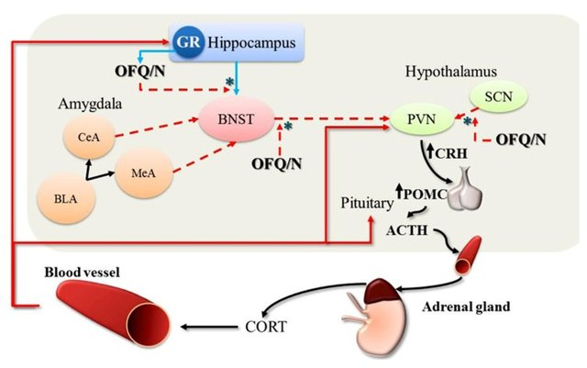
Stress
HPA-axis activation
Stress hormone secretion

Slide 4
Stress = adaptive
Stress is conserved
Ensures survival
Motivation
Attention
Memory
However…

Slide 5
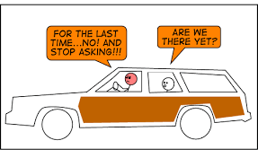
Chronic Stress
Continuous stress ↑ risk of
Anxiety
Depression
PTSD
Homotypic
Heterotypic

Slide 6
*Resilience / Susceptibility to stress*
Internal
Genetics
Development
Nurturing / neglect
Health / exposure pollution
External
Environment
exposure pollution
Social experiences
Dominant / submissive

Slide 7
What is fear learning?
1. Acquisition → touch stove → pain → fear response 2. Consolidation → establish memory not to touch hot stove
(short term memory)
3. Recall → remember in future not to touch not stove
(long term memory)

Slide 8
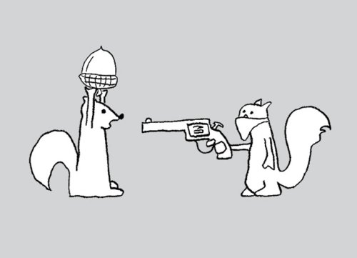
What is fear extinction? (PTSD)
Experience stimulus/context of fear/trauma
↑ hypervigilance / anxiety / fear 1. Acquisition → Realize that the stimulus is no longer threatening
↓ anxiety / fear
2. Consolidation → establish memory that stimulus isn’t dangerous
(short term memory)
3. Recall → remember in future that stimulus isn’t dangerous
(long term memory)

Slide 9
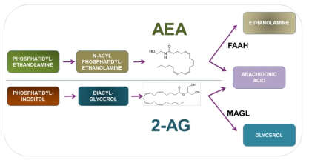
Endocannabinoids

Slide 10
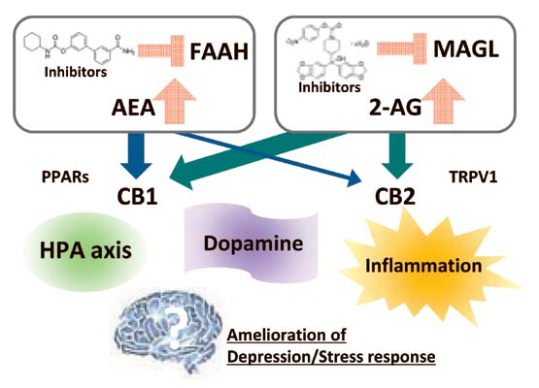
Ogawa & Kunubi 2015

Slide 11
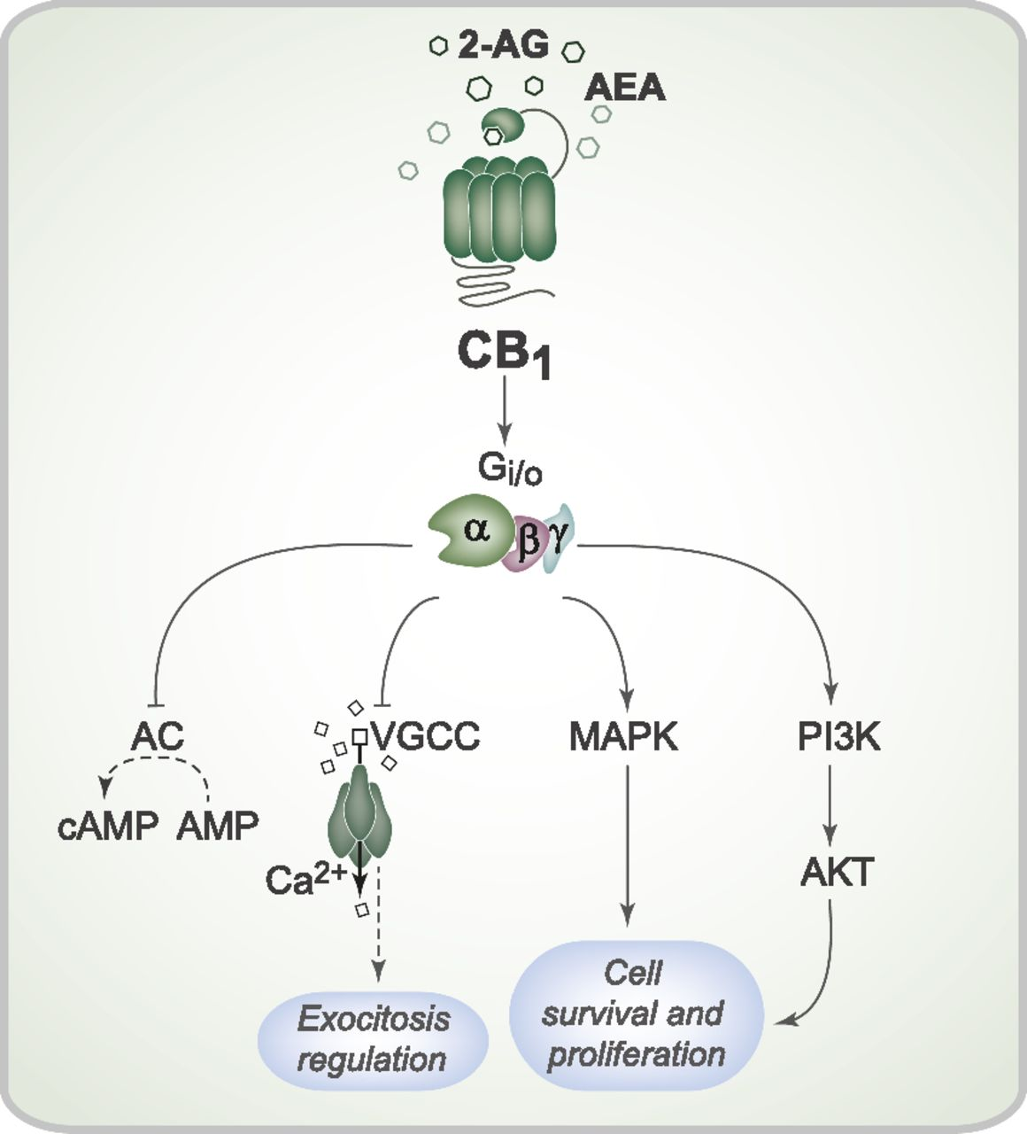
Endocannabinoid Receptors
CB1
Primarily Central Nervous System
Roles in
Appetite
Motor control
Memory
Addiction
* Stress *

Slide 12
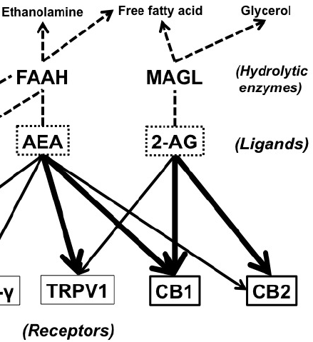

Slide 13
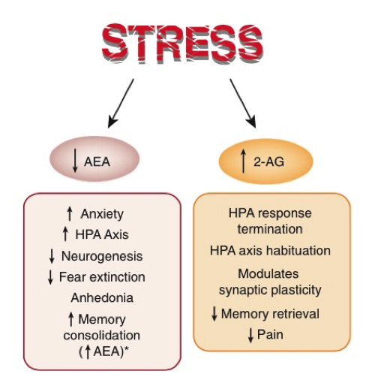
Endocannabinoids & Stress
Maria Morena, Sachin Patel, Jaideep Bains, et al. (2015) Neurobiological Interactions Between Stress and the Endocannabinoid System. Neuropsychopharmacology Reviews (2015), 1-23.

Slide 14
Anandamide

Slide 15
2-AG

Slide 16
2-AG levels in humans
Feder, A., et al. (2018)
Diverse sample of WTC respondors
Avg. 14 years after 9/11
Measured blood plasma [AEA] & [2-AG]
High exposure / low symptoms → ↑ plasma [2-AG]
High exposure / high symptoms
Symptoms = stress-related symptomatology

Slide 17
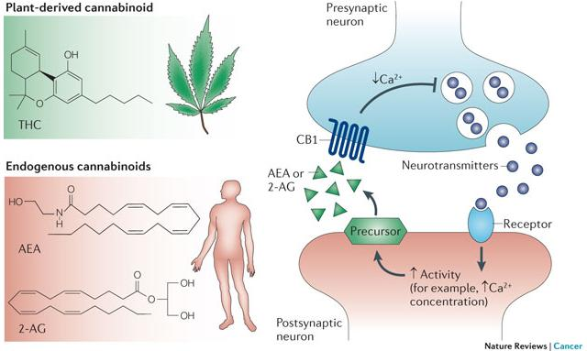
THC → Cb₁

Slide 18
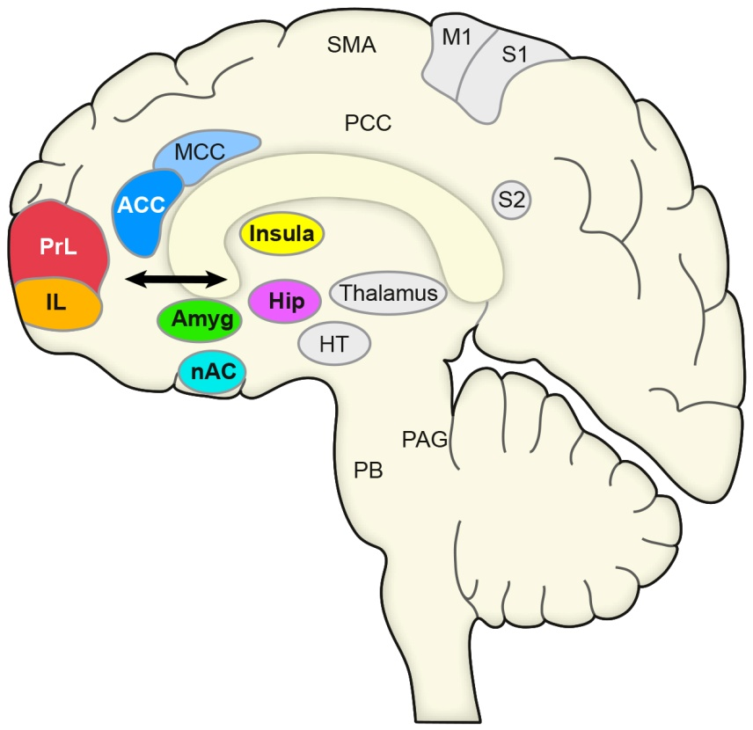
Parts of brain involved in fear memory/extinction
Lots involved…complicated

Slide 19
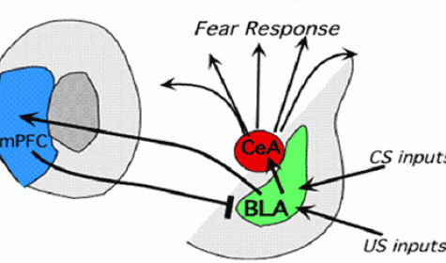
Basolateral Amygdala (LA + BM)

Slide 20
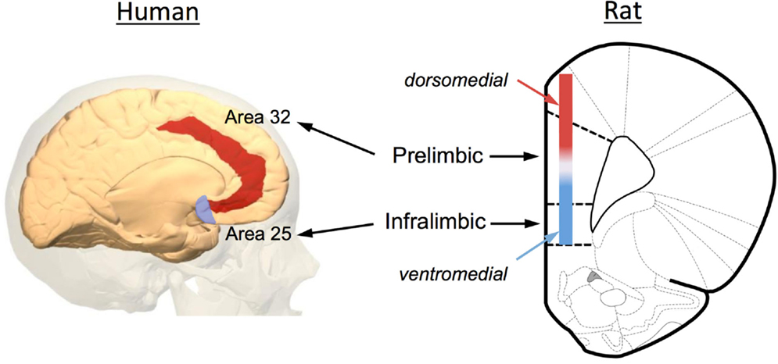
Medial Prefrontal Cortex

Slide 21
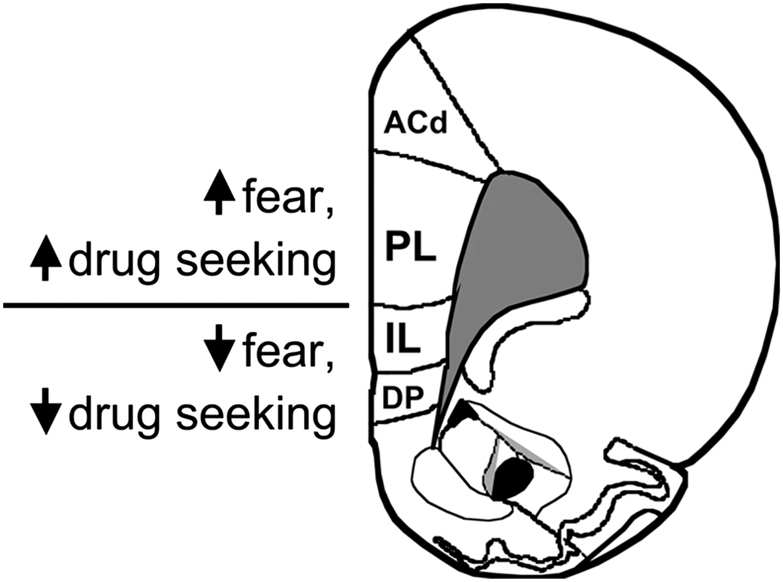
Opposing functions of Prelimbic and Infralimbic Cortex

Slide 22
Prelimbic Cortex
Recruited during fear learning + stress responses
Required for fear learning
Active during stress responses

Slide 23
Infralimbic Cortex
Recruited during fear
extinction

Slide 24
BLA & Prelimbic / Infralimbic
Distinct BLA projection neurons fire to IL & PL
Glutamatergic pyramidal cells
BLA → PL = fear expression (fear “on”)
↑ firing rate during fear conditioning
BLA → IL = fear extinction (fear “off”)
↑ firing rate during fear extinction

Slide 25
What we know
BLA gates fear
eCBs in BLA
PL / IL activity during opposite states of fear learning
Subpopulations of BLA Projection Neurons fire to PL during fear, IL during fear extinction training

Slide 26
What we don’t know
What are the differences in these BLA projection neurons?
How are they recruited?
How are they regulated by BLA interneurons?

Slide 27
Interaction between the Cholecystokinin and Endogenous Cannabinoid System in Cued Fear Expression and Extinction Retention
Bowers M.E., Ressler K.J.

Slide 28
Introduction
Inability to extinguish fear --> fear disorders (e.g. PTSD)
Cb₁ Receptor play a role in..
Emotion
Pain
Feeding
Addiction
Anxiety
Memory

Slide 29
Intro.
Cb₁ KO & systemic antagonism
Block within-session extinction during cued fear
(short term extinction learning)
↑ Freezing
After extinction training
↑ in 2-AG and AEA in BLA

Slide 30
Cb1 highly localized with CCK in the BLA
mRNA + protein level
2 CCK Receptors
CCK_{A} (CCK₁)
CCK_{B} (CCK₂) = G_{q}
Role in fear/anxiety
Elicit panic attack in humans
Elevates anxiety & cued fear
expression ‘in rats

Slide 31
Intro.
eCBs & CCK appear to play opposite roles in fear responses
CCK → CCK_{B} = ↑ panic attacks (humans)
↑ cued fear expression (rodent)
eCBs → Cb₁ = ↑ Extinction of cued fear & fear-potentiated startle

Slide 32
Hypothesis
Activate Cb₁ during fear extinction
↓ probability of CCK from GABA neurons
Prevent fear circuitry activated by CCK_{B}
CCK_{B} Knockout (KO) mice
↑ cued fear extinction
Cb₁ antagonism will not block extinction in KO mice, but it will in Wildtype (WT) mice

Slide 33
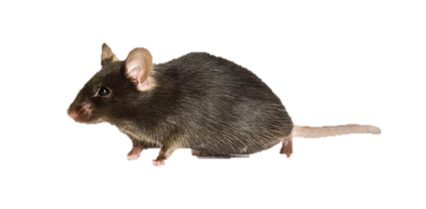
Adult Male (8-12 weeks old) housed in animal colony (24 ºC)
C57BL/6J mice
129-Cckbr^{tm1Kpn}/J

Slide 34
Methods
All behavior performed in light cycle?
handled once per day; 2 days
Separate cohorts of animals for each
behavior measure
Elevated Plus Maze
Open-Field Test
Shock Reactivity
Associative fear conditioning / extinction
Separate cohort of C57BL/6J mice use to test URB597 on anxiety & fear behavior
Open field test
Cued fear extinction test

Slide 35
Methods
Associative fear conditioning / extinction
Cb₁ Antagonist = SR141716 (ip)
3 mg/kg
20 min before extinction training
FAAH Inhibitor = URB597 (ip)
0.1, 0.3, 1 mg/kg
30 min before extinction training

Slide 36
Fear conditioning (drug treatments)
10 CS paired with US
3 CS
Drug injections
+
10 CS trials
(30 sec ITI)
10 CS paired
with US
15 CS trials
Day 1
Day 2
Day 5
Day 6
Day 7
3 days
Fear conditioning
Fear
consolidation
Fear expression
w/ drug treatment
Fear extinction
consolidation
CS – 30 sec tone, 6kHz, 75-80 dB
US – shock at end of tone (500 ms, 1.0 mA)

Slide 37
Fear conditioning (CCKB KO)
3 CS
Drug injections
+
10 CS trials
(30 sec ITI)
5 CS paired
with US
15 CS trials
3 days
CS – 30 sec tone, 6kHz, 75-80 dB
US – shock at end of tone (500 ms, 1.0 mA)
** 129S1 mice increase freezing during FC, extinction and extinction recall

Slide 38
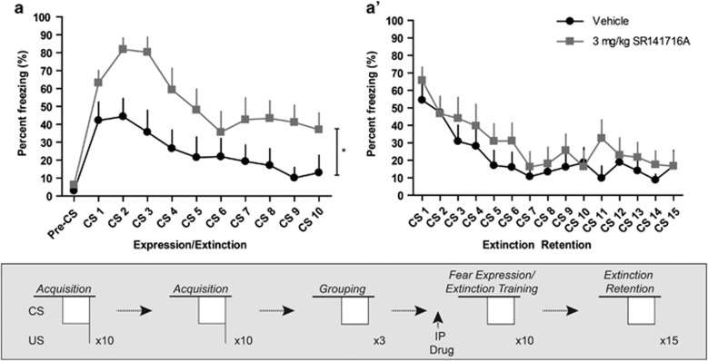
Cb₁ Antagonist = SR141716A
FAAH Inhibitor = URB597
Cb₁ Antagonist
↑ freezing
↓ extinction consolidation (24 hrs after administration)

Slide 39
FAAH Inhibitor
↓ freezing (1 mg/kg)

Slide 40
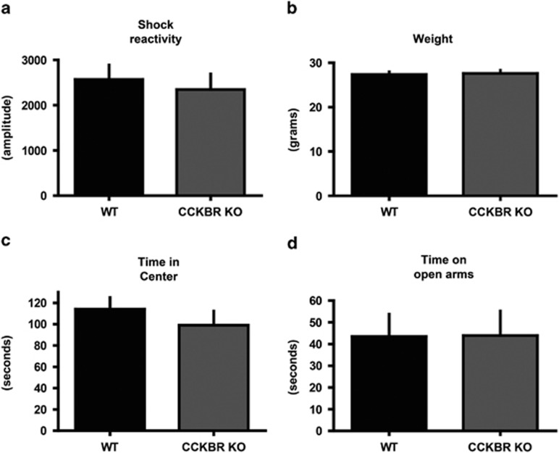
CCKBR KO no difference
Shock reactivity
Weight
Open Field
Elevated plus maze

Slide 41
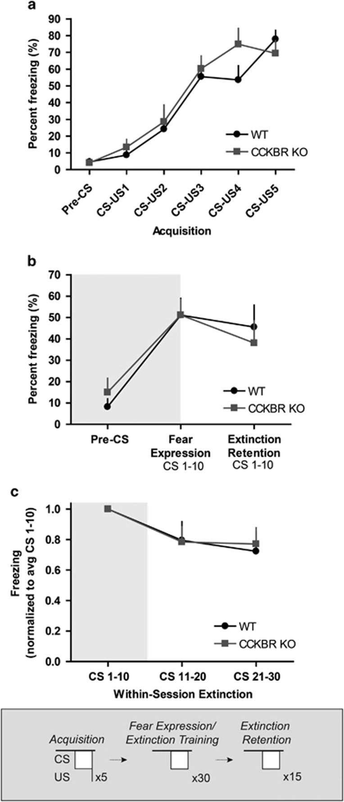

Slide 43
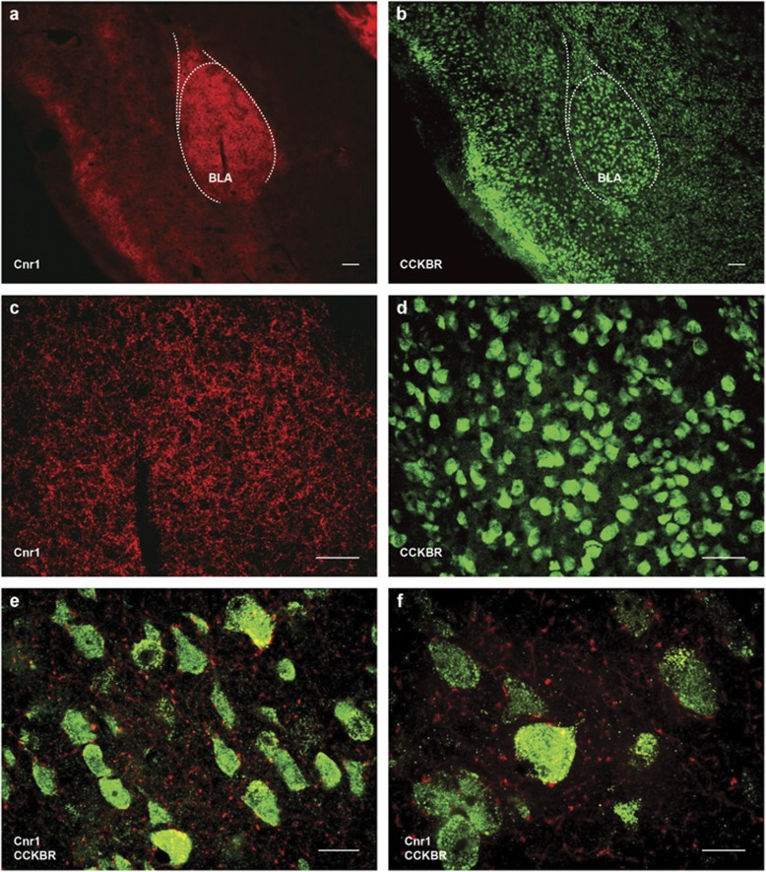
Cb1 → LA, BLA, not CeA
Cb1 → fibers in BLA
CCKBR → LA, BLA, CeA
CCKBR → Cell bodies in BLA

Slide 44
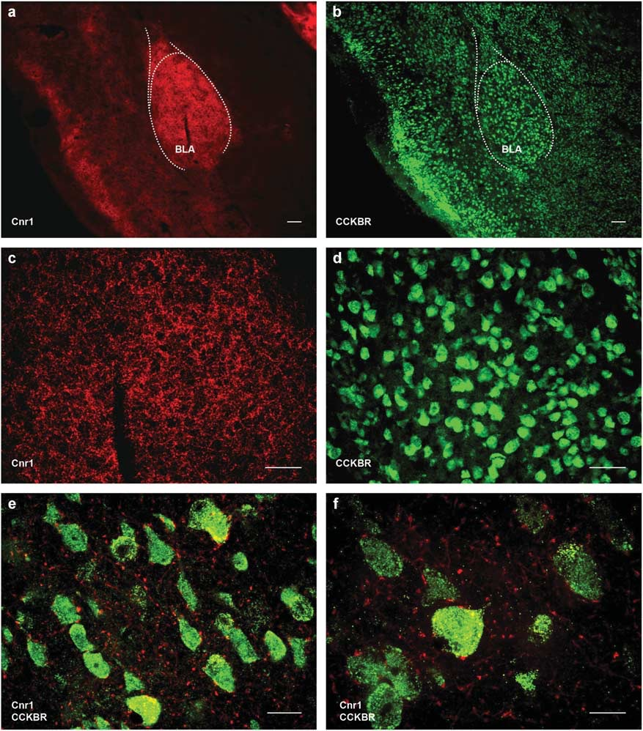
Cb₁ on fibers of the BLA
CCKB on cell bodies of the BLA

Slide 45
Cb₁ form perisomatic baskets around CCKB containing cell
bodies
*But what kind of neurons are these?*
Glutamate?
GABA?
what kind of GABA cells?

Slide 46
CCKB colocalized with Calbindin
CCKB colocalized with Calretinin
CCK colocalized with Parvalbumin
CCK colocalized with CaMKII

Slide 47
Summary
CCKB = anxiogenic
Cb₁ agonism = anxiolytic
Cb₁ antagonism = anxiogenic
CCKB Knockout + Cb₁ = no effect
Cb₁ form perisomatic baskets around CCKB containing cells in the BLA
1.CCKB found most often on Glutamate cells
2. Also on Parvalbum, Calbinidin, Calretinin Interneurons

Slide 48
Projection-Specific Dynamic Regulation of Inhibition in Amygdala Micro-Circuits
Vogel E., Krabbe S., Grundemann J., Cusulin JIW, Luthl A.

Slide 49
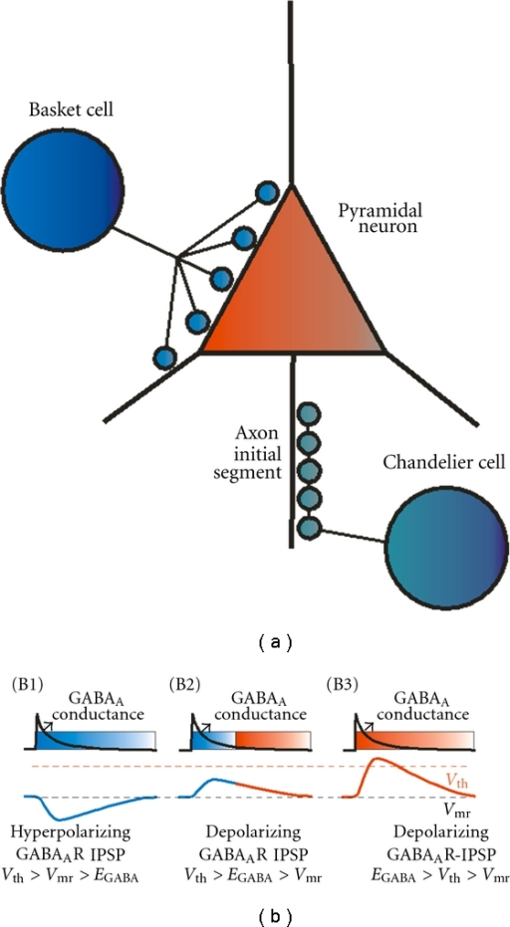
Principal Neurons (PN)
Pyramidal, Glutamatergic
Long projections
function determined by
Site of projection
Type of neurons being
projected to
Activity of PN
What innervates the neuron

Slide 50
How do PNs next to each other have opposing functions?
Basolateral Amygdala
Distinct populations of IL or PL projecting PNs
CCK interneurons expressing Cb₁ target PNs
Difference in regulating??
BLA → IL
BLA → PL

Slide 51
High fear state
PN_{PL}s highly active (in vivo)
Low fear / acquisition of extinction
PN_{IL}s → ↑ activity (in vivo)
Fear states mediated by shift in activity of these 2 neuron types?
Circuit mediating this shift is unknown

Slide 52
Large Cholecystokinin neurons (CCK_{L})
***only interneuron expressing Cb₁ in Amygdala
Distinct from small calretinin/VIP coexpressing CCK neurons in amygdala
CCK

Slide 53
Hypothesis
Local Basal Amygdala (BA) CCK_{L}’s differentially inhibit subpopulations of PNs
Inhibit PL & IL differently?

Slide 54
Methods
Mice group housed
12 hr light / dark
Ab libitum food + water
Mice expressing Flp under GABAergic promotor Dlx (Dlx-Flp)
Crossed with CCK-IRES-Cre-driver mice
Resulting progeny
Exclusive GFP expression in Cre⁺/Flp⁺ GABAergic, but not Cre⁺/Flp⁻ glutamatergic CCK neurons

Slide 55
Organization of CCK_{L} on specific BLA PNs?
Paired Whole-cell-recordings
CCK_{L}s + retrogradely labeled projection neurons
4-10 week CCK-IN-GFP male mice
GFP in CCK interneurons selectively
Ex vivo (brain slices)
Histology
6-8 week old male CCK-IN-GFP + WT littermates

Slide 56
CCK-IRES-Cre::Dlx-Flp::RCE:dual reporter
Cholecystokinin
Internal Ribosomal Entry Site
Cre (recombinase)
Pan-GABA promotor
Cre-activated RCE reporter expression
is almost entirely restricted to GABAergic neurons and includes
almost all GABAergic neurons

Slide 57
(Dlx-Flp)
mice
CCK-IRES-Cre Cre-driver
mice
Dlx-Flp::CCK-IRES-Cre
offspring
RCE::dual conditional reporter
mice
CCK-IN-GFP
mice

Slide 58
Retrograde Tracing
*shows what cells in the BLA project to the IL/PL
Bilaterally into IL or PL
Red fluorophore coated latex beads (Lumafluor) →electrophysiology
(1-14 days recovery)
Alexa 555-conjugated Choleratoxin-B (0.1µL) (binds ganglioside G M1)
or
CAV2-Cre virus (0.1µL) → histology (10 days recovery)

Slide 59
(B) mPFC-projecting BA PNs were visualized with tdTomato expression after injecting a CAV2-cre virus into mPFC of hCar::tdTomato mice.

Slide 60
D) Separated CCK_{L} by cell size

Slide 61
Electrophysiology
B) Apply current to CCK_{L} → IPSP on PN_{IL} + PN_{PL}
C + D) verify IPSPS by blocking GABA_{A} with PTX

Slide 62
Equal # connections from CCK_{L} to PN_{IL} + PN_{PL}
populations
Single
Action
Potential
50ms
100 Hz
APbursts
No diff. in synaptic conductance
of PN_{IL} + PN_{PL}

Slide 63
IPSP Latency is the same between PN_{IL} + PN_{PL}
Measuring AP threshold to IPSP onset
“Jitter” is the same between PN_{IL} + PN_{PL}
Standard deviation from IPSP latency

Slide 64
Different Cb₁ expression between PN_{PL} + PN_{IL}?
Depolarization of PN will inhibit
presynapses projecting to it by
releasing endocannabindoids
Assessed DSI (Depolarization-Induced Suppression of Inhibition)
↑Depolarization of PNs ↓ inhibition by CCK_{L}s
eCB form of short-term plasticity
Depolarize
(0 mV, 5sec)
Record from
CCK_{L}
Axon term.
(Suppression
from 2-AG)
Depolarize CCK_{L} axon
Terminals
(8 APs, 20Hz / 10sec)
(CCK →CCKBR→2-AG )
2-AG

Slide 65
A)
CCKL → PN_{IL}
B) DSI abolished by Cb₁ antagonist

Slide 66
C + D) DSI observed in all
CCK_{L} --> PN_{IL}
but not
CCK_{L} --> PN_{PL}
E) DSI magnitude much greater
in CCK_{L} --> PN_{IL}

Slide 67
Other Short term plasticity diff?
B) Brief presynaptic high bursts
(100 Hz, 5 pulses)
→ PN_{IL} = stronger depression
A) Paired Pulse Ratio – no difference

Slide 68
So far..
Both CCK_{L} → PN_{IL} + PN_{PL} have equal synaptic connectivity and strength
BUT
CCK_{L} –> PN_{IL} = more susceptible to activity-dependent suppression
Are mechanisms PRESYNAPTIC or POSTSYNAPTIC??

Slide 69
C) Cb₁ agonist applied PN_{IL} + PN_{PL} depressed in a similar magnitude + time course
D) No diff in suppression by Cb₁ agonist
*DSI differences cannot be explained by presynaptic mechanisms
*Tested if CCK tonically inhibited by Cb₁ (applied Cb₁ antagonist)
because ex vivo?

Slide 70
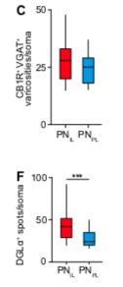
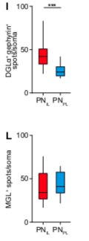
Postsynaptic differences? DGLα + MGL
*Differences not due to cell sizes*
C)
No diff. in # of CCK_{L}
Cb₁ terminals
I)
Verifies F)
F)
PN_{IL} have 50% more DGLα apposed Cb₁
L)
No diff. in #
of MGL spots

Slide 71
Differences in DGLα after fear learning?
D)
Auditory CS
paradigm
5 US-CS pairings

Slide 72
BEFORE FC
AFTER FC

Slide 73
Summary
In the BLA
PN_{IL} + PN_{PL} neurons regulate expression/memory of fear in opposite fashion
PN_{IL}
More susceptible to activity dependent suppression
***Increased DAGLα on cell bodies***
***No difference in
# of MGL spots on CCK_{L}
# of CCK_{L} Cb₁ terminals
Connectivity and strength of CCK_{L} innervations

Slide 74
Endocannabinoid signaling modulates susceptibility to traumatic stress exposure
Bluett RJ, et al. 2018

Slide 75
Introduction
Stress = risk for depression anxiety
Resilience
↓ risk of psychopathology
***Active adaptation***
Not the absence of maladaptive behaviors induced from stress
2-AG may have a role in promoting stress-resilience
Acute traumatic stress
Successful adaptation to repeated homotypic stress

Slide 76
Introduction
AEA acts as stress “buffer”
↑ AEA levels
↓ Unconditioned anxiety
↓ Stress-induced increases in
Anxiety
Cort release
Dendritic remodeling
↑ extinction learning
Stress → ↓ brain AEA levels

Slide 77
Determine2-AG’s role in stress resilience
Inhibit Monoacylglycerol Lipase (MAGL)
JZL-184 (8mg/kg⁻¹)
↓
↑ 2-AG levels (reduce breakdown)
What effects on stress-induced anxiety behaviors using NIH test?

Slide 78
JZL-184
Increased 2-AG levels
JZL-184
Decreased AA levels
JZL-184
AEA not effected

Slide 79
Novelty-induced hypophagia (NIH)
Reduction in
food intake
Highly sensitive to acute traumatic stress & eCB manipulation
Measure latency to consume food

Slide 80
The NIH test
4 training days in the home cage
30 min habituation to red light
After habituation, water was replaced with highly palatable substance
Latency to consume and total consumption recorded
After 4th training day
Foot-shock Stress (1 or 5 days)
1 test day in novel cage
24 hrs after last shock session → novel cage testing
red light for 60 min
transferred to new, empty cages in a brightly lit room (~300 lux) with 30 min access to Ensure
Latency to drink and total consumption were recorded.
*Mice were singly housed for 4 days before training;
cages were not changed for the duration of the experiment.

Slide 81
JZL ↓ feeding latency
No stress
1 day stress
5 day stress
co-admin. Rimanabant (1 mg kg⁻¹) Cb₁ Antagonist blocks

Slide 82
F) no stress
G) 1 day stress
H) 5 days stress
*All mice JZL treated mice eating by the time ~50% of controls

Slide 83
JZL ↑ consumption
no stress
1 day stress
5 day stress
co-admin. Rimanabant (1 mg kg⁻¹) Cb₁ Antagonist blocks

Slide 84
Cb₁ Antagonist
↑ feeding latency
↓ consumption

Slide 85
JZL-184
↑distance travelled in light zone
↓ latency to enter light zone

Slide 86
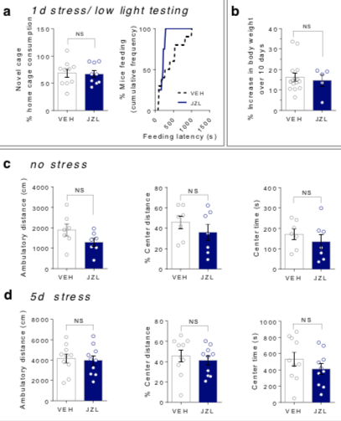
JZL-184
No impact on locomotor
Activity in Open Field Test
(1 or 5 day stres
No impact consumption after
acute NIH stress
No impact on weight gain
over the 10 days
*Anxiolytic effects not related to
Appetitive or consummatory drive
Or result of altered locomotion

Slide 87
2-AG →Cb₁ modulates stress-induced anxiety
But…
2-AG → Cb₁
signals impact susceptibility to developing stress-induced anxiety ?

Slide 88
Repeated novelty induced hypophagia (rNIH)
Days 1-4: Home cage latency
Day 5: Novel cage test baseline
Day 6-9 : Rest
Days 10-11: Home cage latency
Day 11 Shock stress
Day 12: 2nd Novel cage test

Slide 89
Foot-shock stress
7.5-min session in FC chamber
1. 60 sec baseline
2. (6) 0.7 mA foot-shocks (1 min apart)
3. Each shock coincided with the last 2 s
of a 30 s auditory tone
4. Additional 60 sec, mice returned to
home cages.
All post-stress behavioural testing was performed ∼24 h after completion of the final stress exposure.

Slide 90
Resilient / Susceptible separated (stress induced change in latency to feed)
Resilient < 120 sec
Susceptible > 120 sec

Slide 91
Retrospective examination of baseline NIH latency
*Indicates BASELINE anxiety (not stress-induced)
does not predict stress susceptibility

Slide 92
Resilient animals
Those with HIGHEST baseline latency
largest decrease in latency after stress
(Conforms resilient nature)

Slide 93
**Susceptible animals**
↑latency to open arm (EPM)
↓ open arm entries (EPM)
↓ time in center (OFT)

Slide 94
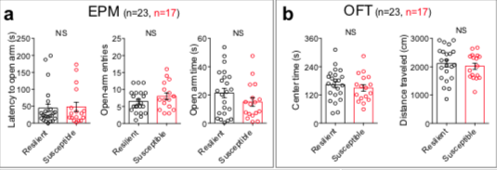
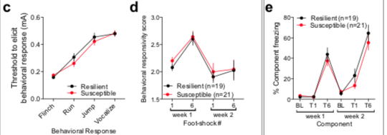
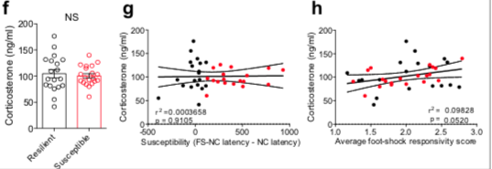
Separate Cohort
Organized into susceptible /resilient
Ran through EPM + OFT pre-stress
No difference in anxiety in EPM/OFT
No diff in Cort levels following
week of 2-foot shock stress
NIH stress
No diff. in sensory processing of foot-shock
C) sensitivity threshold
D) behavioral response to shock
E) Fear learning + recall
`BL = baseline T1 = tone T6 = tone + 2 shock
week 1 T6 freezing = within-session learning (STM)
week 2 Baseline freezing = context recall
week 2 T1 freezing = context + tone recall

Slide 95
VEHICLE
treatments
1. Baseline Training home cage feeding latency (day 1-4)
2. Novelty Cage feeding latency (day 5)
3. Baseline Training home cage feeding latency (days 6-7)
4. Novelty Cage Foot-shock-stress Latency (day 8)
5. Baseline Training home cage feeding latency (days 9-10)
6. Novelty Cage Foot-shock-stress Latency (day 11)
No differences in consumption
*Susceptible*
↑ Foot shock stress induced latency

Slide 96
*
*
*
Novelty Cage feeding latency → Vehicle Treatment (Day 5)
Novelty Cage Foot-shock-stress Latency→ Vehicle Treatment (day 8)
Novelty Cage Foot-shock-stress Latency → JZL-184 Treatment (day 11)
Novelty Cage Foot-shock-stress Latency → Cb₁ Antagonist (day 13)
*Susceptible*
↑ latency (day 8)
JZL ↓ latency to resilient levels (day 11)
* Cb₁ Antagonist ↑ latency in both

Slide 97
1
2
3
Stress-susceptibility ratios
Separate cohorts of mice (N=40) 3 weeks treatment
1. Vehicle treatment---------→12 susceptible
2. JZL-184 ----------------------→ 3 susceptible
3. JZL-184 + Cb₁ Antagonist→ 15 susceptible

Slide 98
*JZL-184 reversed susceptibility
to stress after it had manifested
Severity of stress-induced increase
in latency to consume correlated with
the effectiveness of JZL treatment
*JZL most anxiolytic for animals who
were most anxious after first shock
(had largest increase in latency to eatafter first stress)

Slide 99
2-AG Depletion ?
DO34 (50 mg kg⁻¹)
DAGL inhibitor
Reduce 2-AG but not AA/AEA
Hypothesis:
Increase susceptibility to stress-induced anxiety behavior

Slide 100
Whole Population
↑ feeding latency post FS compared to vehicle
↓ consumption post FS compared to vehicle

Slide 101
Resilient Animals
2nd FS (DO34) ↑ feeding latency compared to vehicle
Susceptible Animals
DO34 didn’t chance latency from
vehicle treatment with 1st FS

Slide 102
Not due to appetitive chances (J)

Slide 103
Elevated Plus Maze 24 hrs post stress exposure
DO34 → 1. ↓ % open arm distance travelled
2. ↓ open arm time
3. ↓ willingness to explore outside ½ of open arm

Slide 104
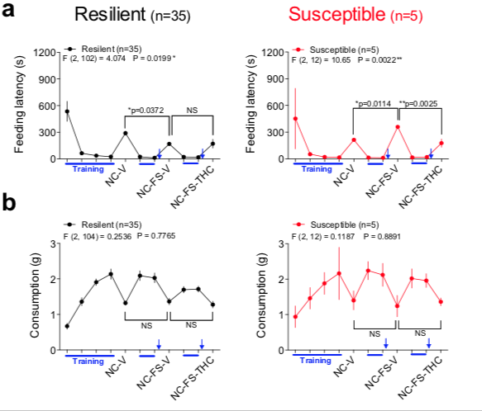
Cannabis
High use among individuals with PTSD
Low dose THC, (0.25 mg kg⁻¹)

Slide 105
DAGLα KO in BLA
developed a floxed mouse line for conditional Cre-dependent deletion of the primary central 2-AG synthetic enzyme DAGLα (DAGLα^{f/f})

Slide 106
Gene Cassette flanked w/
Flipase recognition Target site sequences
mouse ENgrailed 2 gene Splice Acceptor
Exon 8
Exon 9
Internal Ribosomal Entry Site
NEOmycin (mammal)

Slide 107
Offpspring = DGLα^{flp/+} or DGLα^{+/flp}
DGLα^{flp/flp}

Slide 108
AAV5.CMV.PI.eGFP.WPRE.bGH
Control (no Cre)
AAV5.CMV.HI.eGFP-Cre.WPRE.SV40

Slide 109
Doesn’t affect locomotor / anxiety in OFT

Slide 110
↓ ambulatory distance
↓ # light a entiresa
↓ time in light zone (not sig.)

Slide 111
Baseline latencies equal
No divergence after 1 stress exposure
*Conditional BLA KO – 5 days stress exposure

Slide 112
Synaptic Circuit involved in BLA DAGLα stress-induced behavior?

Slide 113
AAV5.CaMKIIa.hChR2(H134R)-eYFP.WPRE.hGH
perfused into
1. ventral Hippocampus (vHIP)
2. Prelimbic Cortex (PL)
3. LEC (Lateral Entorinhal Cortex)z

Slide 114
Cb₁
Antagonist
3 weeks
Optogenetically stimulate
Record from labaled BLA cells
vHIP input showed the largest sensitivity to phasic 2-AG-mediated retrograde inhibition

Slide 115
NIH test relies on perceived novelty of environmental context
vHIP-BLA circuit is considered to be anxiogenic
Uncover the role of 2-AG signalling at these synapses
Stress resilience associated with this connection?

Slide 117
Connection vHIP-BLA synapses
STONGER in stress susceptible
oDSE?
oDSE at vHIP-BLA synapses
↓in stress-susceptible

Slide 118
JZL application restores oDSE at vHIP-BLA synapses
In stress susceptible

Slide 119
↑ oDSE in Susceptible
Doesn’t ↓ # oEPSP
*PHASIC not tonic 2-AG signaling in resilient group

Slide 120
Summary
Resilient animals
Resilience not indicative by baseline anxiety
↓ connectivity strength from vHIP to BLA
↑ 2-AG mediated suppression of vHIP terminals
JZL-184 can make susceptible animals behave like resilient one (stress induced feeding latency)
DO34 can make resilient animals behave like susceptible ones (stress induced feeding latency)

Slide 121
Resilient / Susceptible animals can be organized using rNIH paradigm
(feeding latency 24 hrs. post foot shock)
Resil. < 120s
Suscep. > 120s
More anxious in EPM + OFT

Slide 122
More questions
What effect does vHIP projection to BLA have on influencing the recruitment of the IL + PL ?
Implication in relationship between eating disorders and mood disoders?

